Slide 1
Japan, India Regional Marketing Manager
Takumi Yoshiya

Slide 2
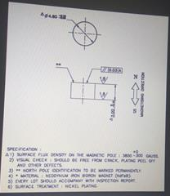
Magnet and working area
Condition : 20mT < √(Bx^2+By^2) < 70mT
24mT < Bz < 126mT
Magnet
4.8mm
z
3.0mm
Working Area(x-y plane)
y
2.5 ~ 3.0mm
10mmφ
x

Slide 3
Thank you very much

